Slide 1
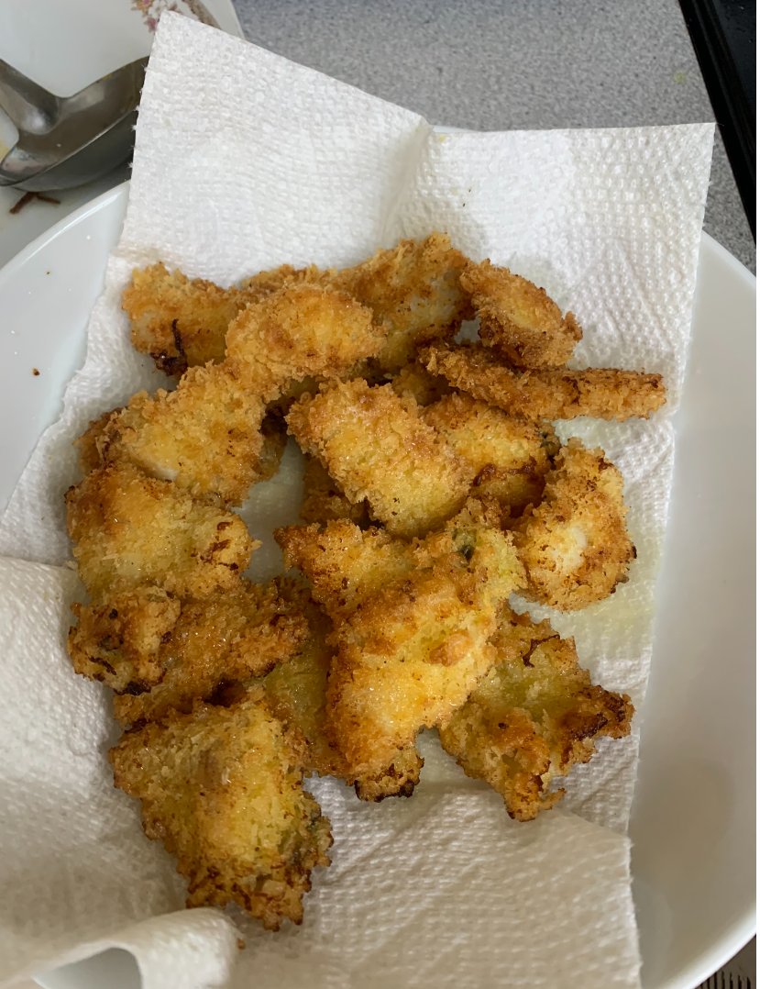
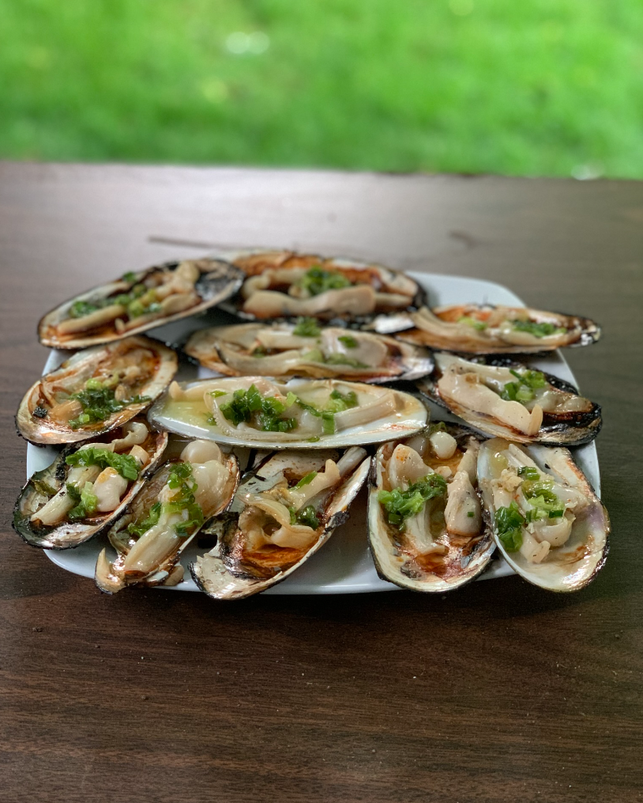
(Lam’s) Razor Clam Food

Slide 2
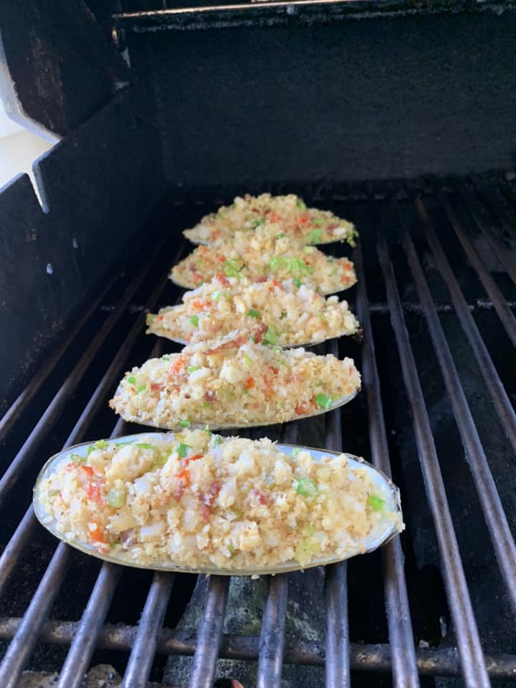
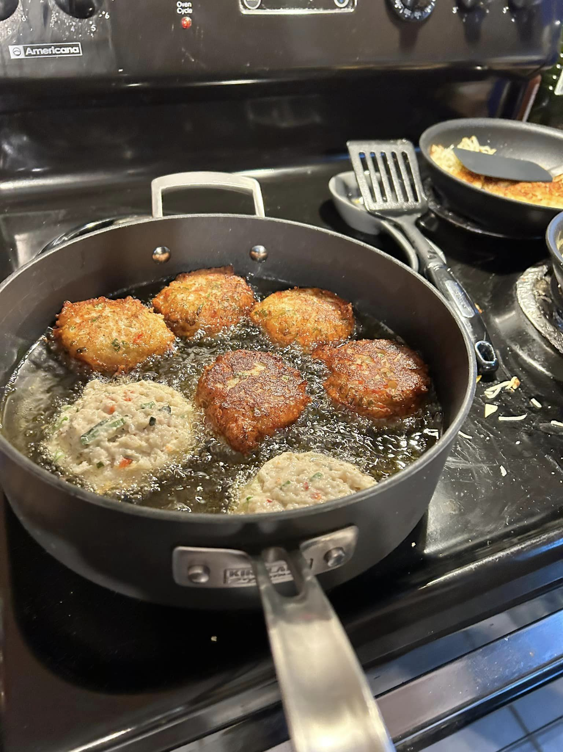
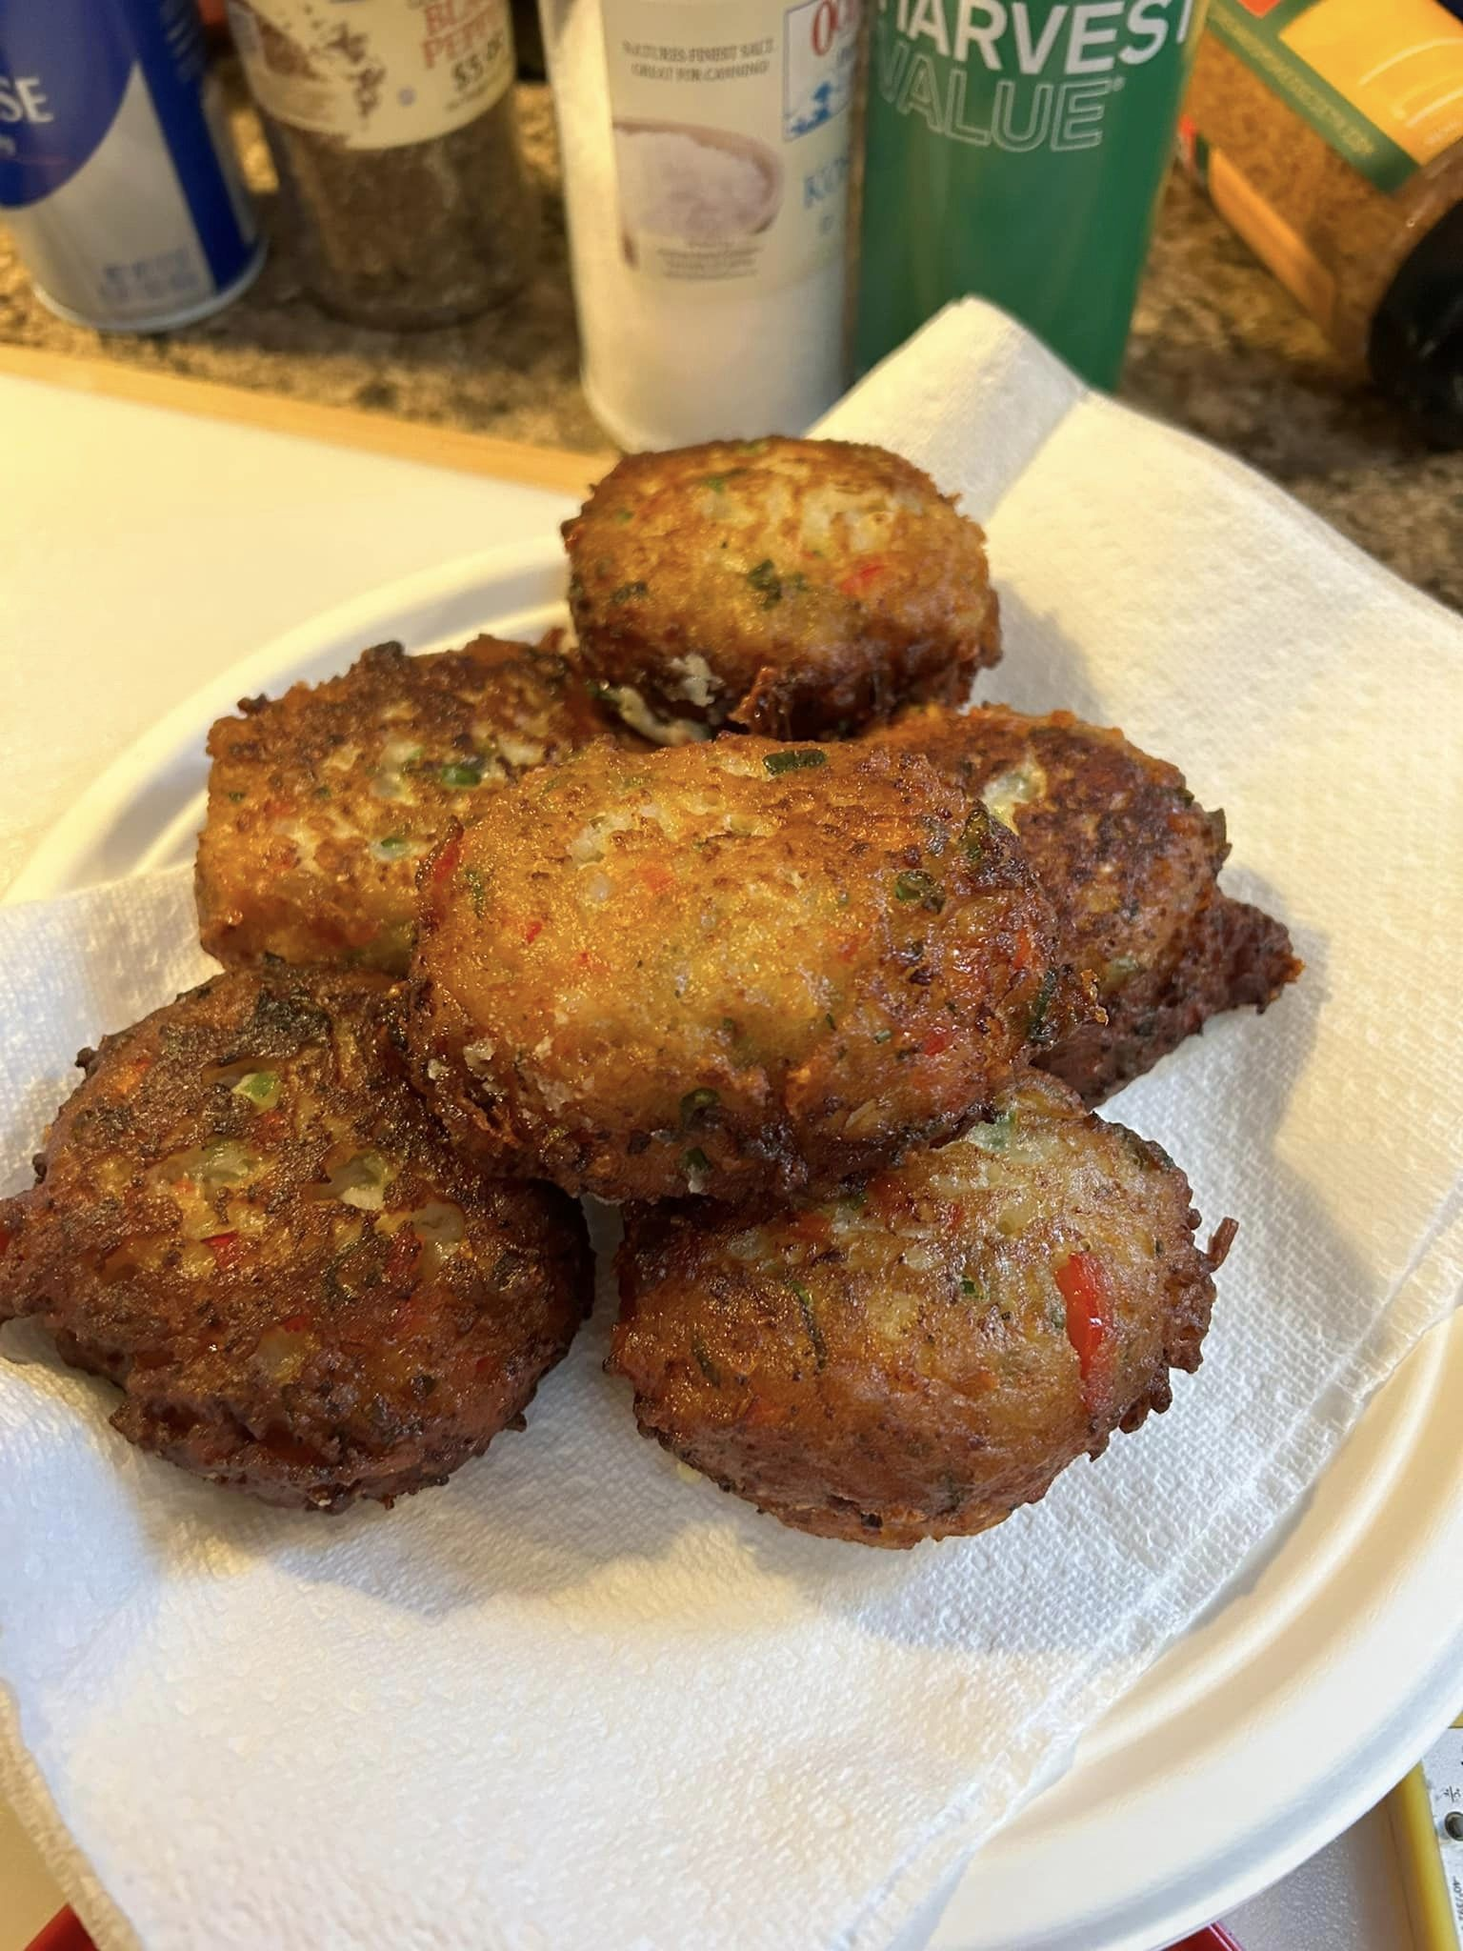
Others’ Razor clam food (FB Washington State Razor Clamming public group)

Slide 3
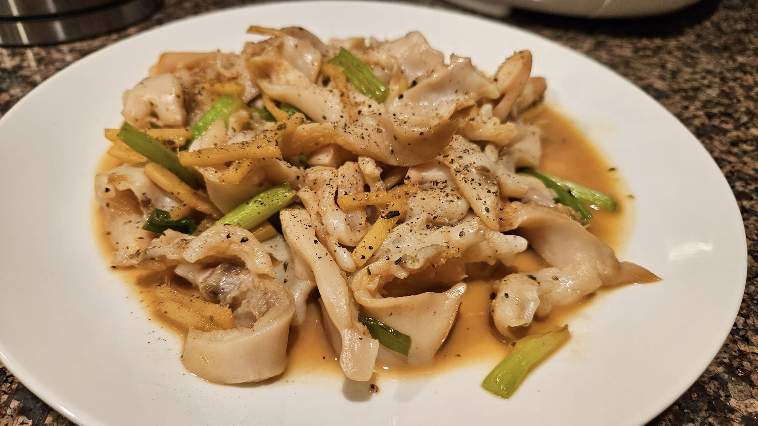
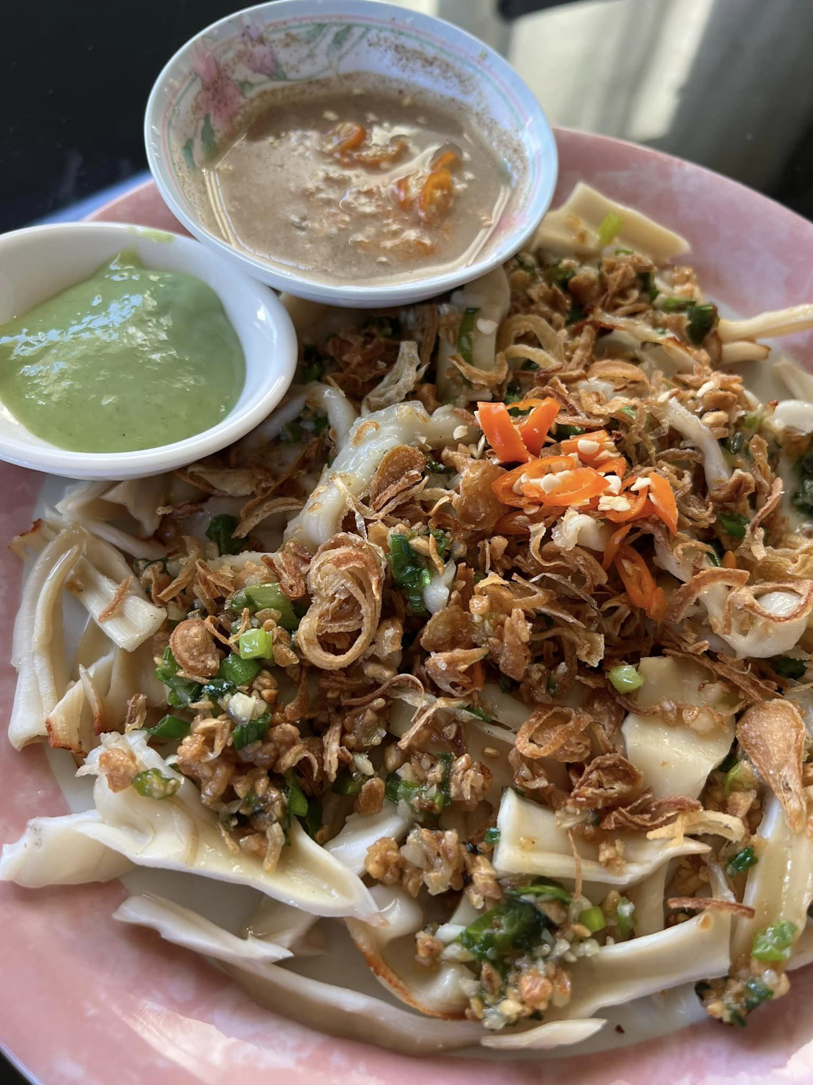
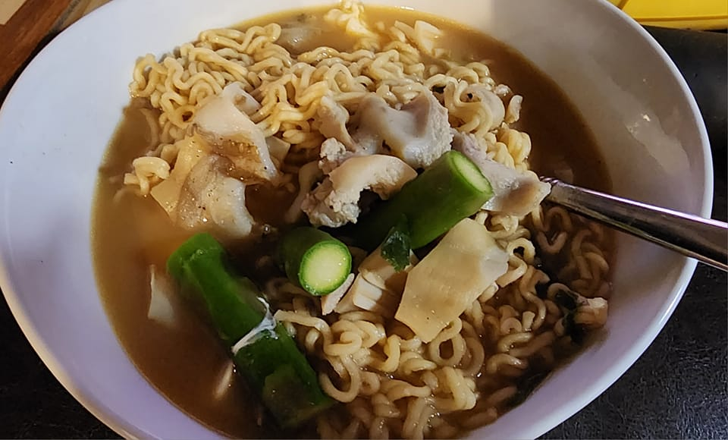
Others’ Razor clam food (FB Washington State Razor Clamming public group)

Slide 4
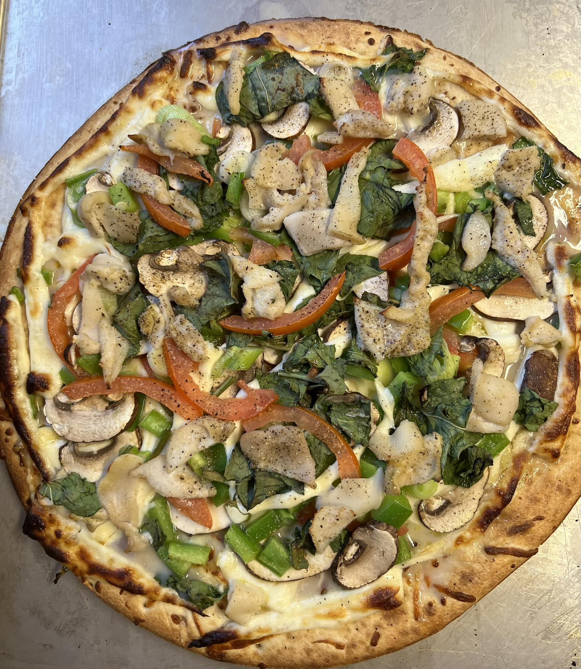
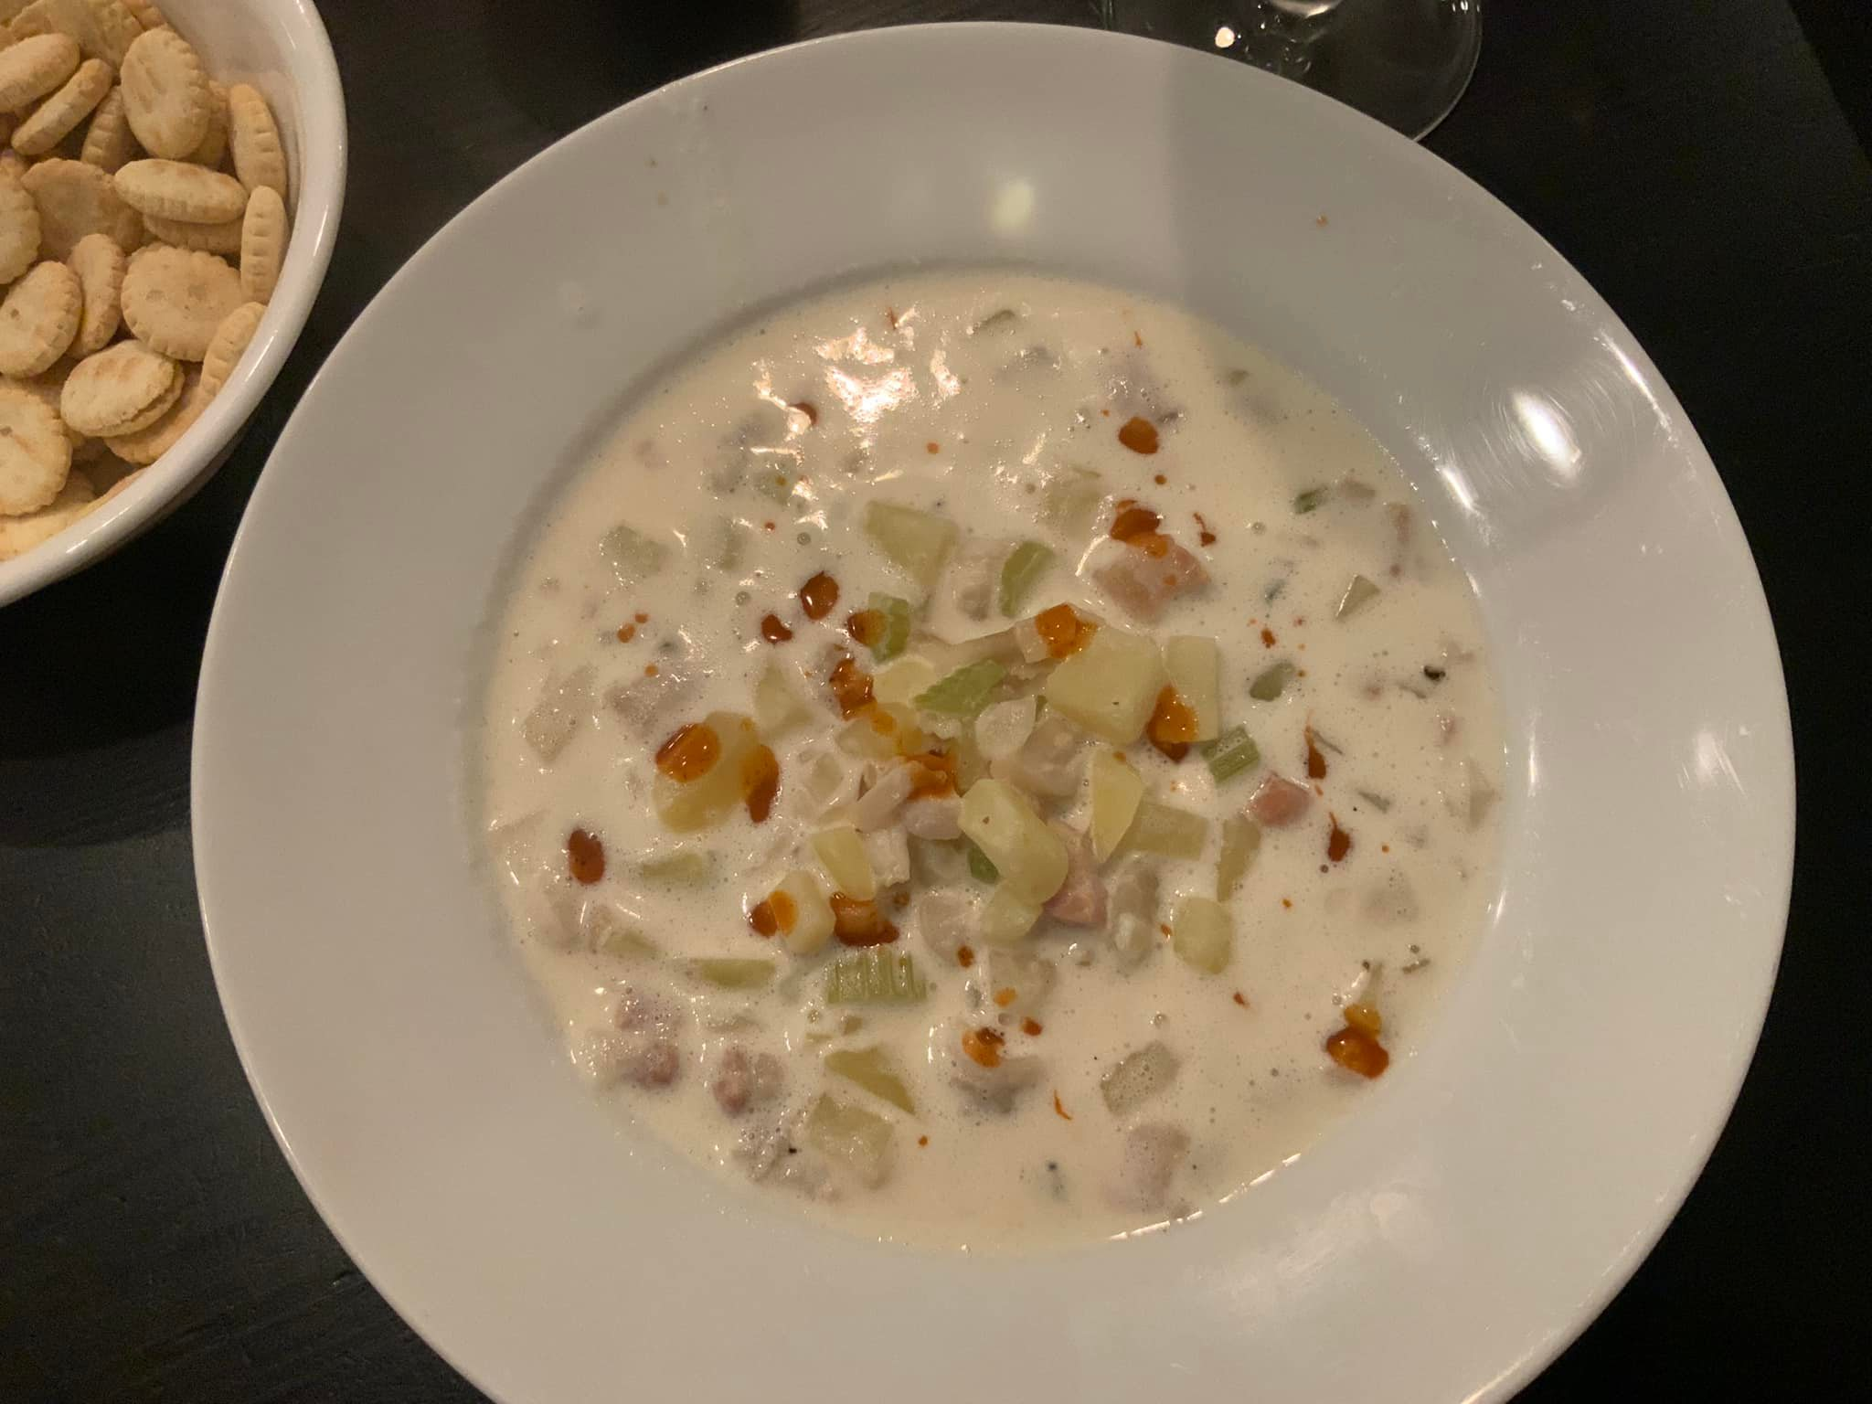
Others’ Razor clam food (FB Washington State Razor Clamming public group)

Slide 5
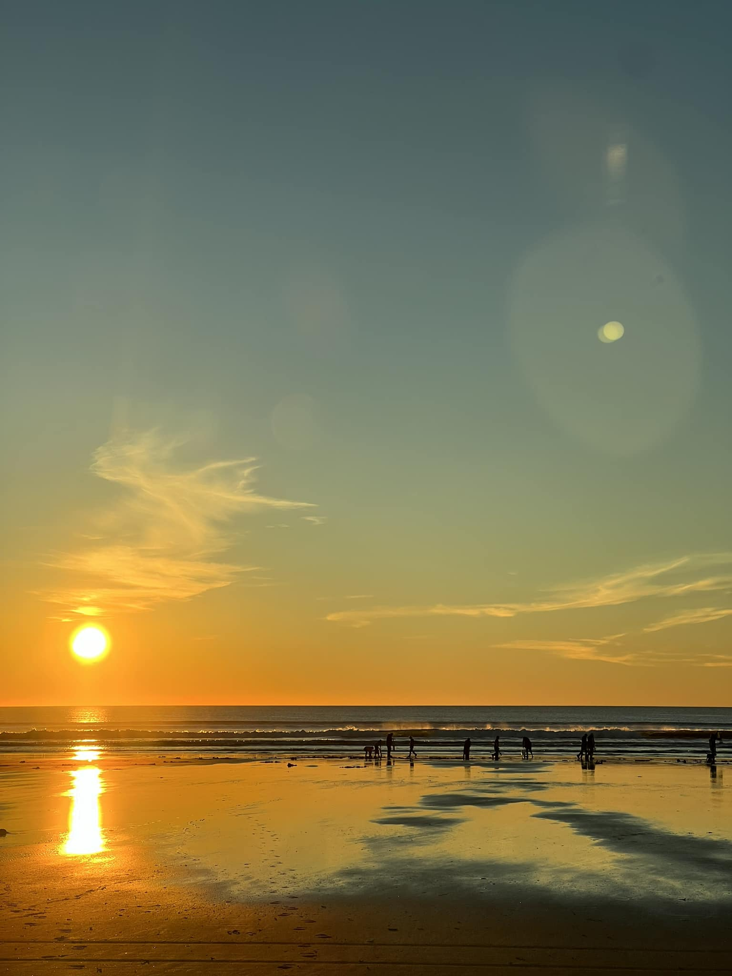
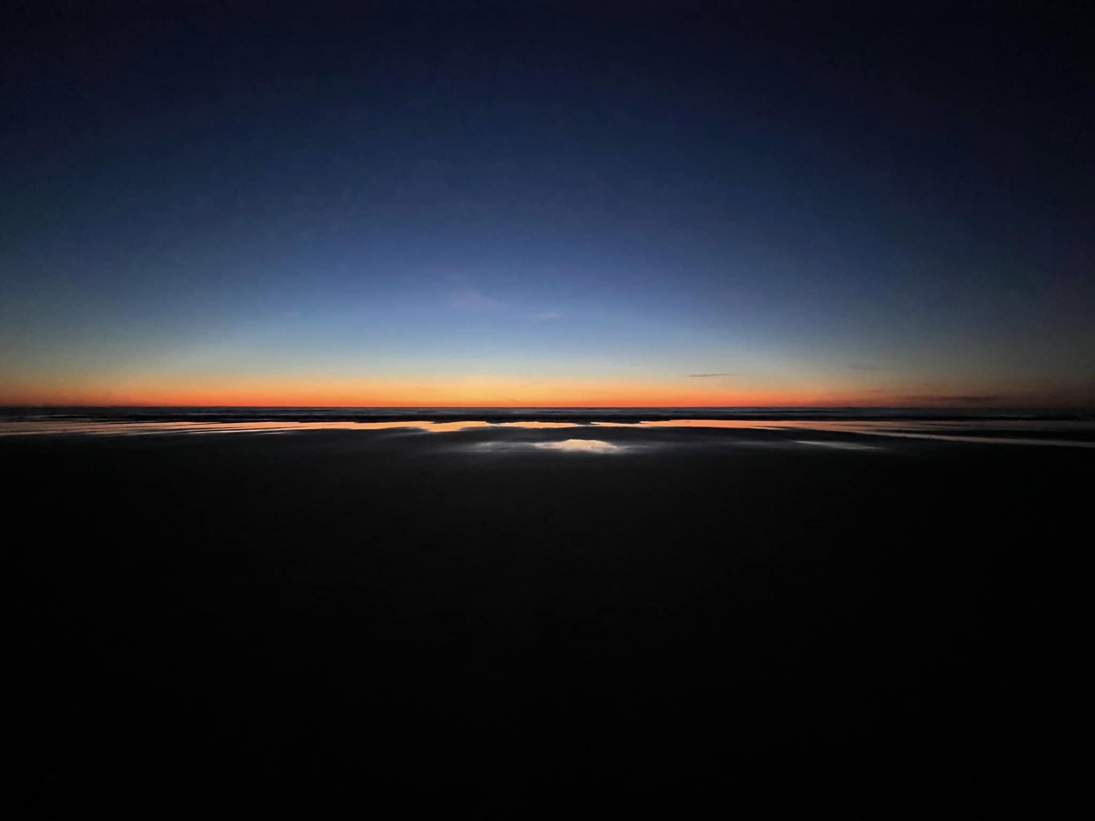
Others’ awesome shots of the beaches (FB Washington State Razor Clamming public group)

Slide 6

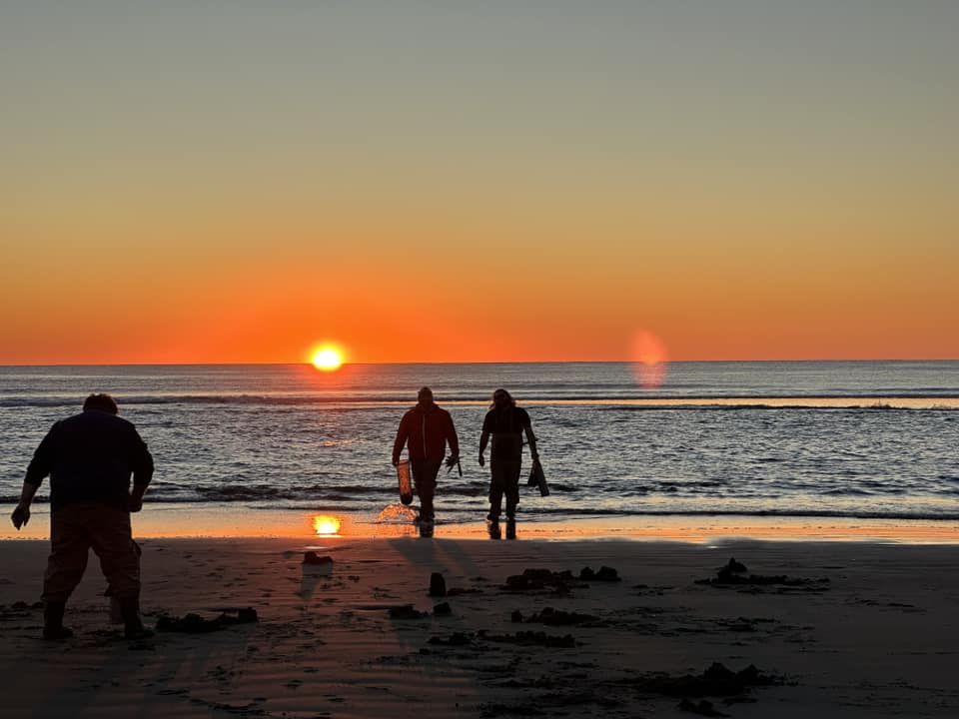
Others’ awesome shots of the beaches (FB Washington State Razor Clamming public group)

Slide 7
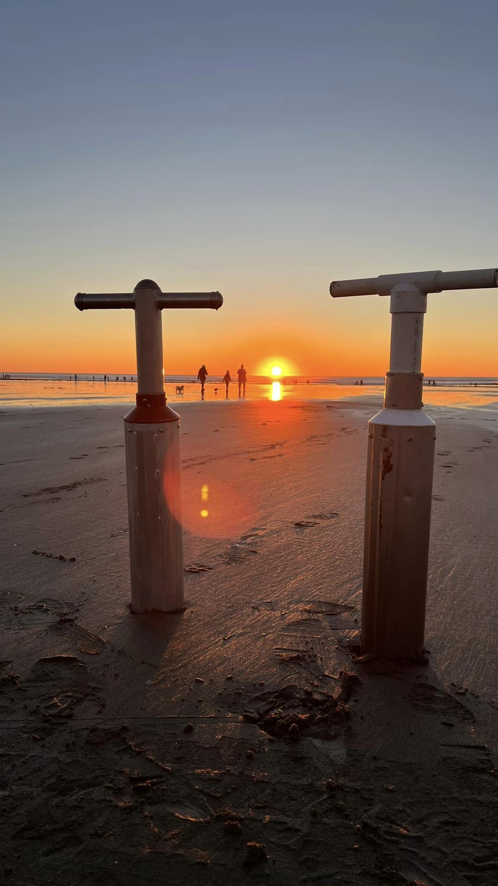
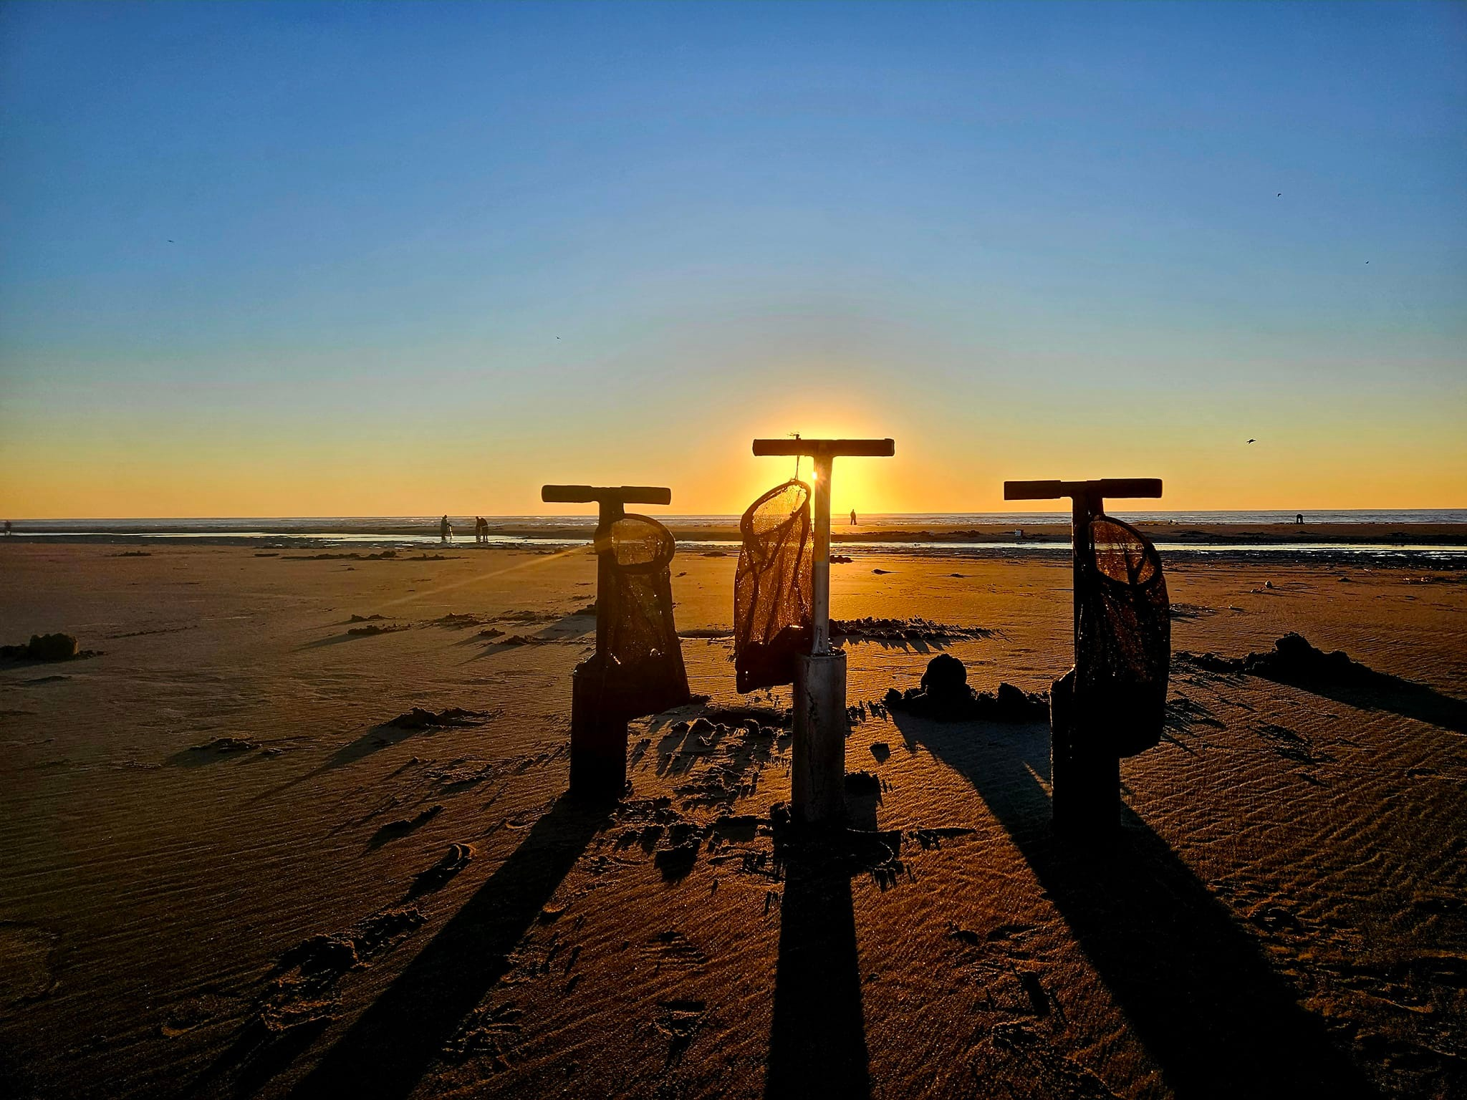
Others’ awesome shots of the beaches (FB Washington State Razor Clamming public group)

Slide 8
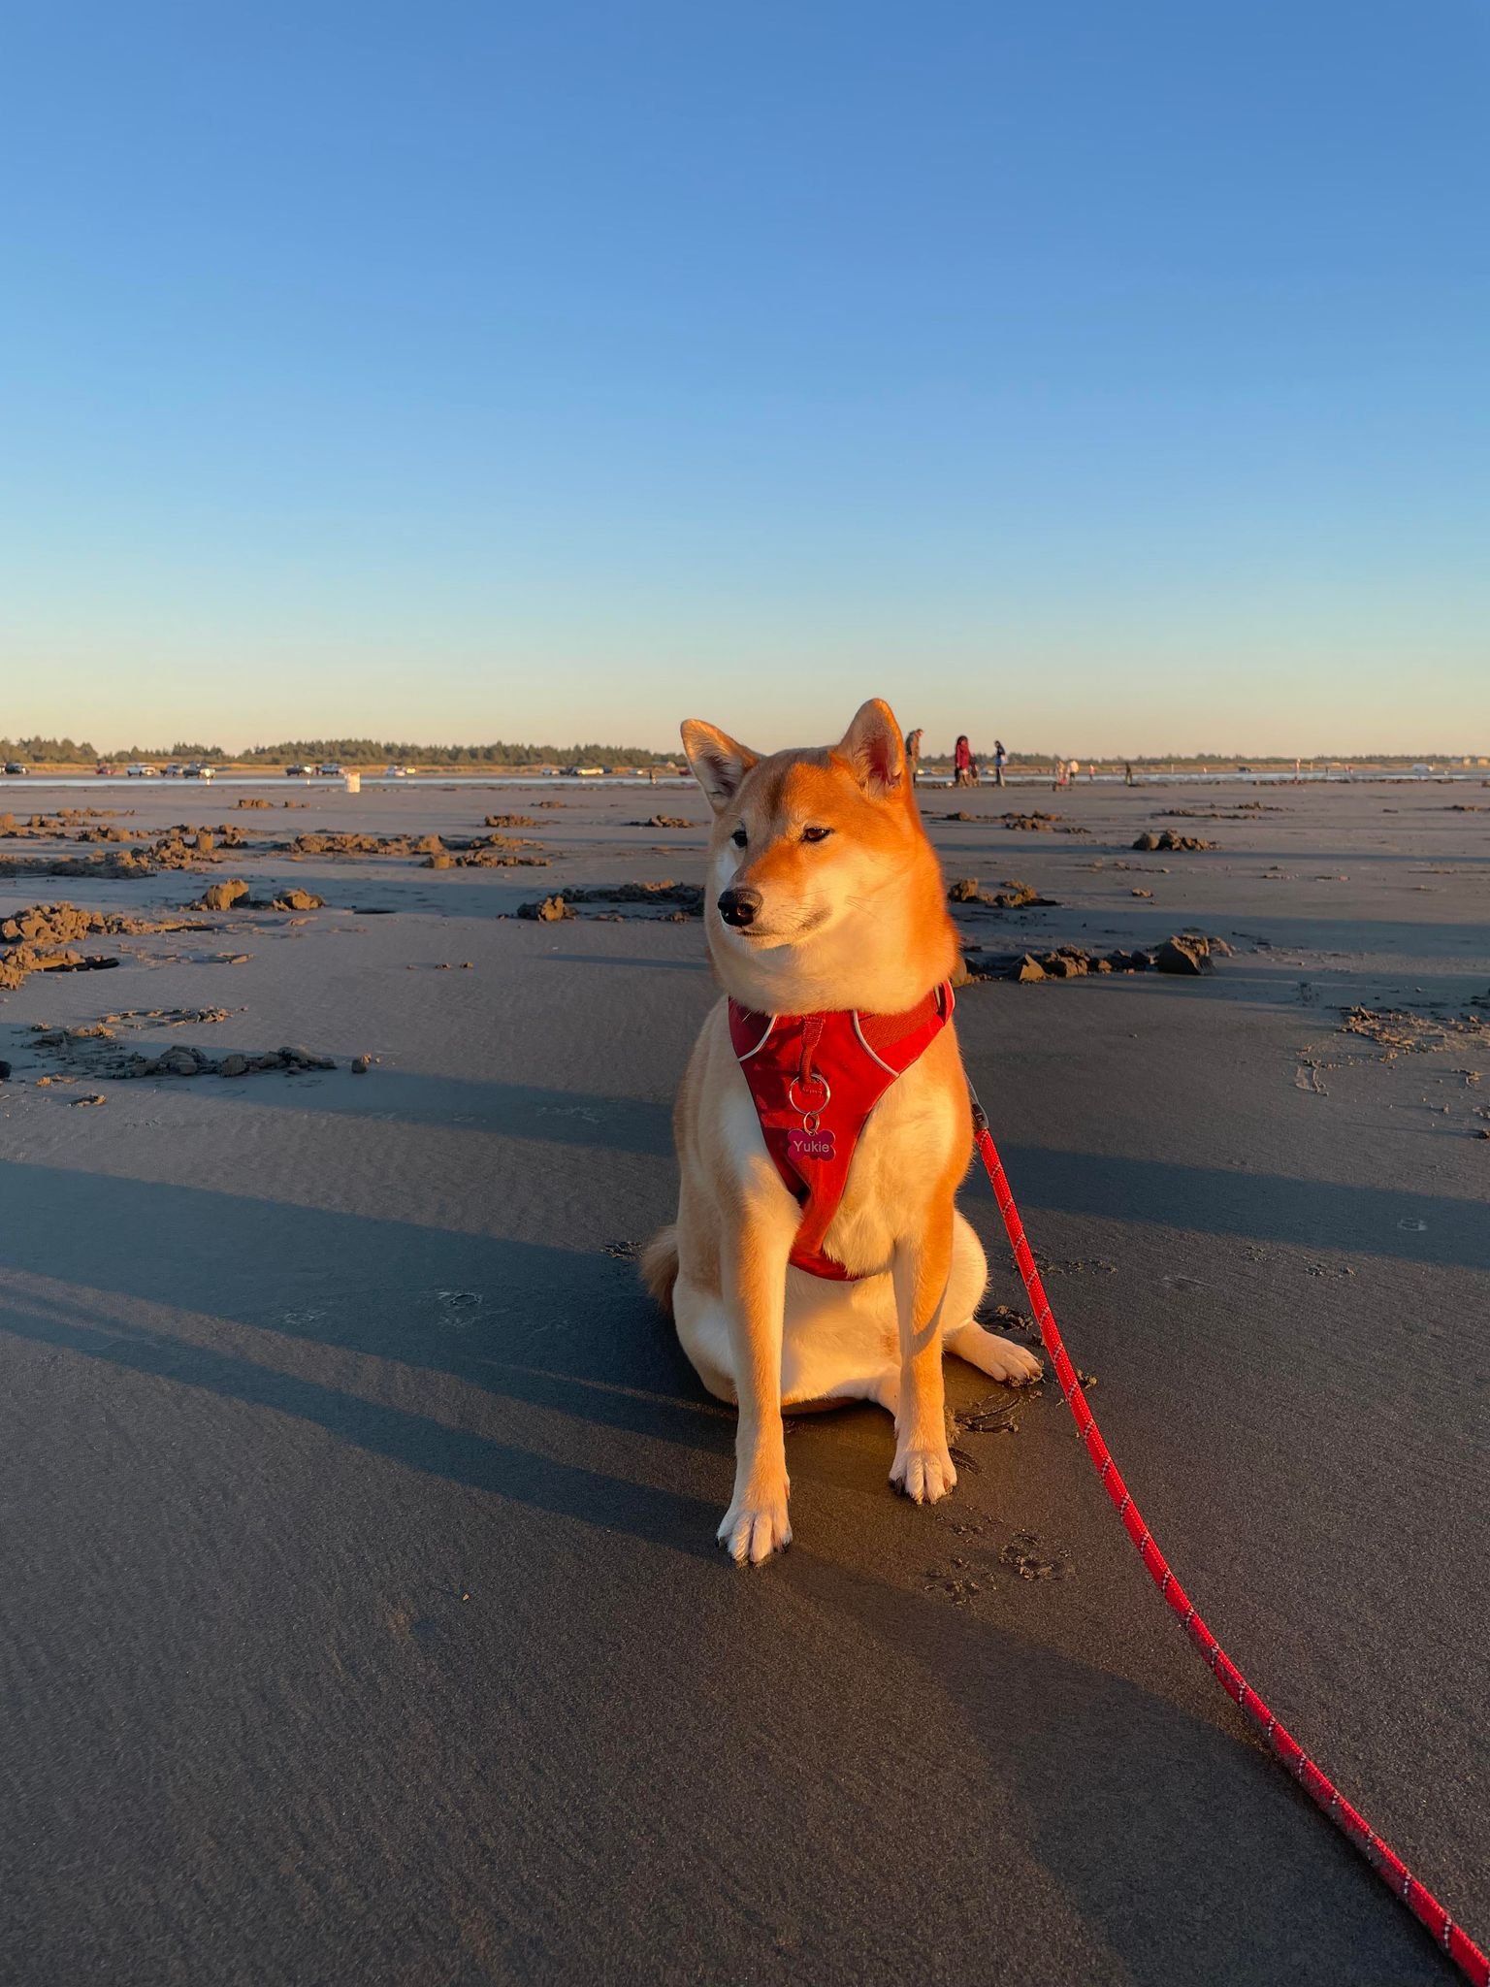
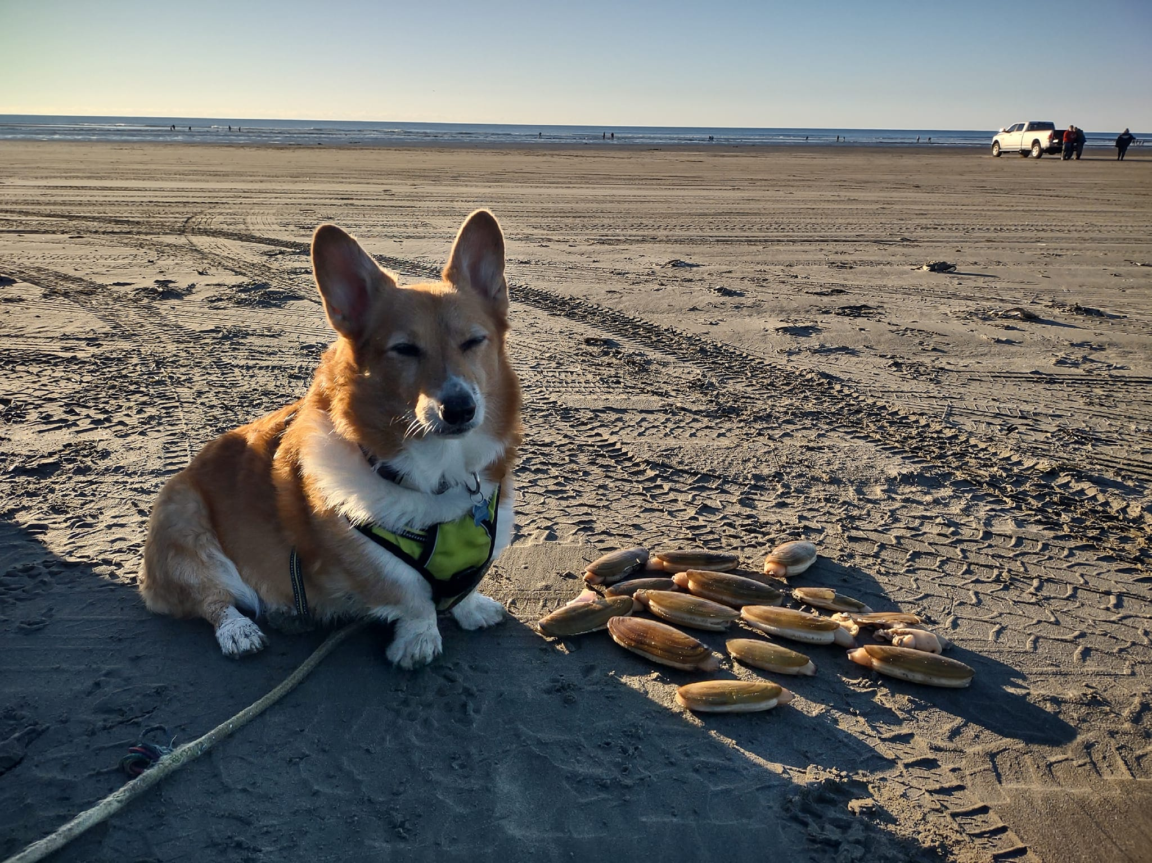
Others’ awesome shots of the beaches (FB Washington State Razor Clamming public group)

Slide 9
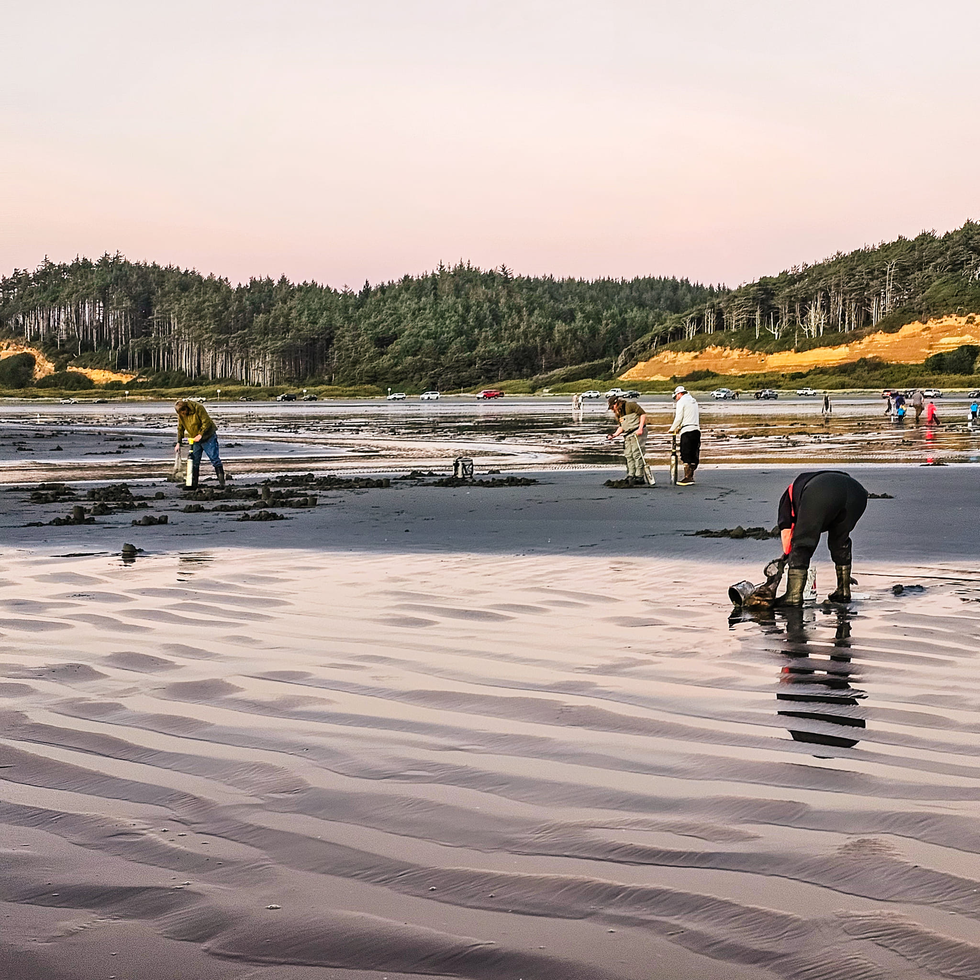
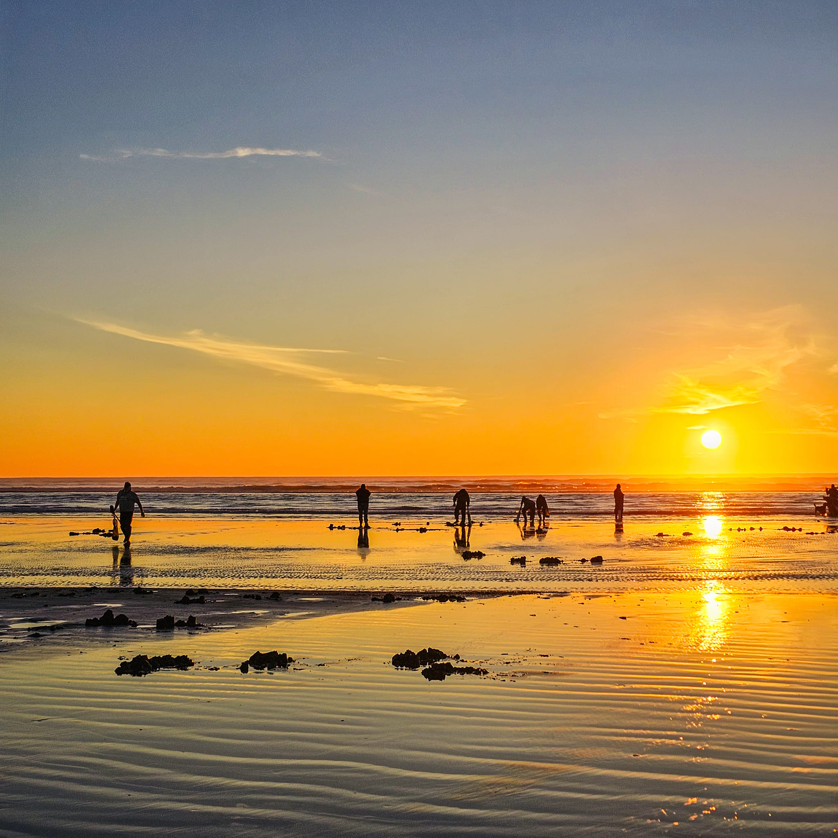
Others’ awesome shots of the beaches (FB Washington State Razor Clamming public group)

Slide 10
Razor Clam License
https://wdfw.wa.gov/licenses/fishing/types-fees
LICENSE TYPES | RESIDENT (AGED 16-69) | NON-RESIDENT | RESIDENT SENIOR (AGED 70+) | YOUTH (AGED 15)* | RESIDENT DISABLED** | NON-RESIDENT DISABLED VETERAN**
Annual Shellfish/Seaweed | $17.40 | $36.10 | $7.50 | Must Purchase Annual Combo | Must Purchase Annual Combo | $35.00
Annual Combo Fishing/Shellfish | $55.35 | $124.65 | $19.05 | $8.05 | $11.35 | $55.35
Annual Razor Clam | $14.10 | $21.80 | $14.10 | Must Purchase Combo | Must Purchase Combo | $21.80
3-day Razor Clam | $9.70 | $9.70 | $9.70 | $9.70 | $9.70 | $9.70

Slide 11
More info
https://wdfw.wa.gov/fishing/shellfishing-regulations/razor-clams
15 caught clams per person regardless of size. CANNOT put them back into the sand.
Lower the tides & closer to the surf, the easier it is to find (big) clams.
Check WDFW site the day before to make sure digging is approved for the dates.
Always face the ocean to watch for incoming waves and bring headlights, especially on night digs
Follow the cars to stay on harden sand so you don’t get stuck!
Dress warm, follow the rules, respect the environment, and keep recreational razor clamming sustainable.

Slide 12
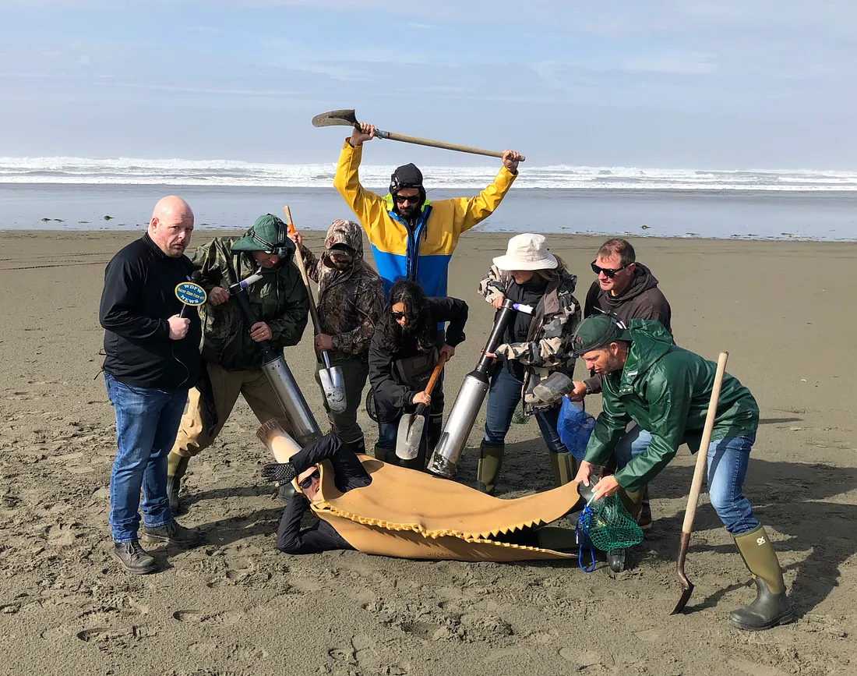
The End.

